Slide 1

Morfa Bay 2026
Monday 27th April – Friday 1st May
ARRIVAL 8.00 – 8.10am

Slide 2
Kit List -
A copy can be found on our Website

Slide 3
Packing
It’s important that packing is done with your child – they need to know where everything is, and how to re-pack for the return home. ALL items need to go back into their original case/bag – there is not enough room on the coaches for additional bags of loose/dirty clothing
Trying to squash everything into a small cabin sized bag will not be helpful… ensure the bag you use has plenty of room
Using labelled bags for clothes like;
  Assault course clothes
    Quite often assault course (old) shoes will get ‘lost’ during the course – they WILL need an additional old pair for when they do the beach activity
  Disco clothes
    We really do want the children to keep these nice for he disco and BBQ night

Slide 4
LUGGAGE ALLOWANCE
* Main bag/case containing EVERYTHING on the KIT LIST
* Sleeping bag and pillow in named black bag
PLEASE DROP YOUR LUGGAGE BY THE COACHES IN THE MAIN DRIVEWAY FOR LOADING on the morning of departure

Slide 5
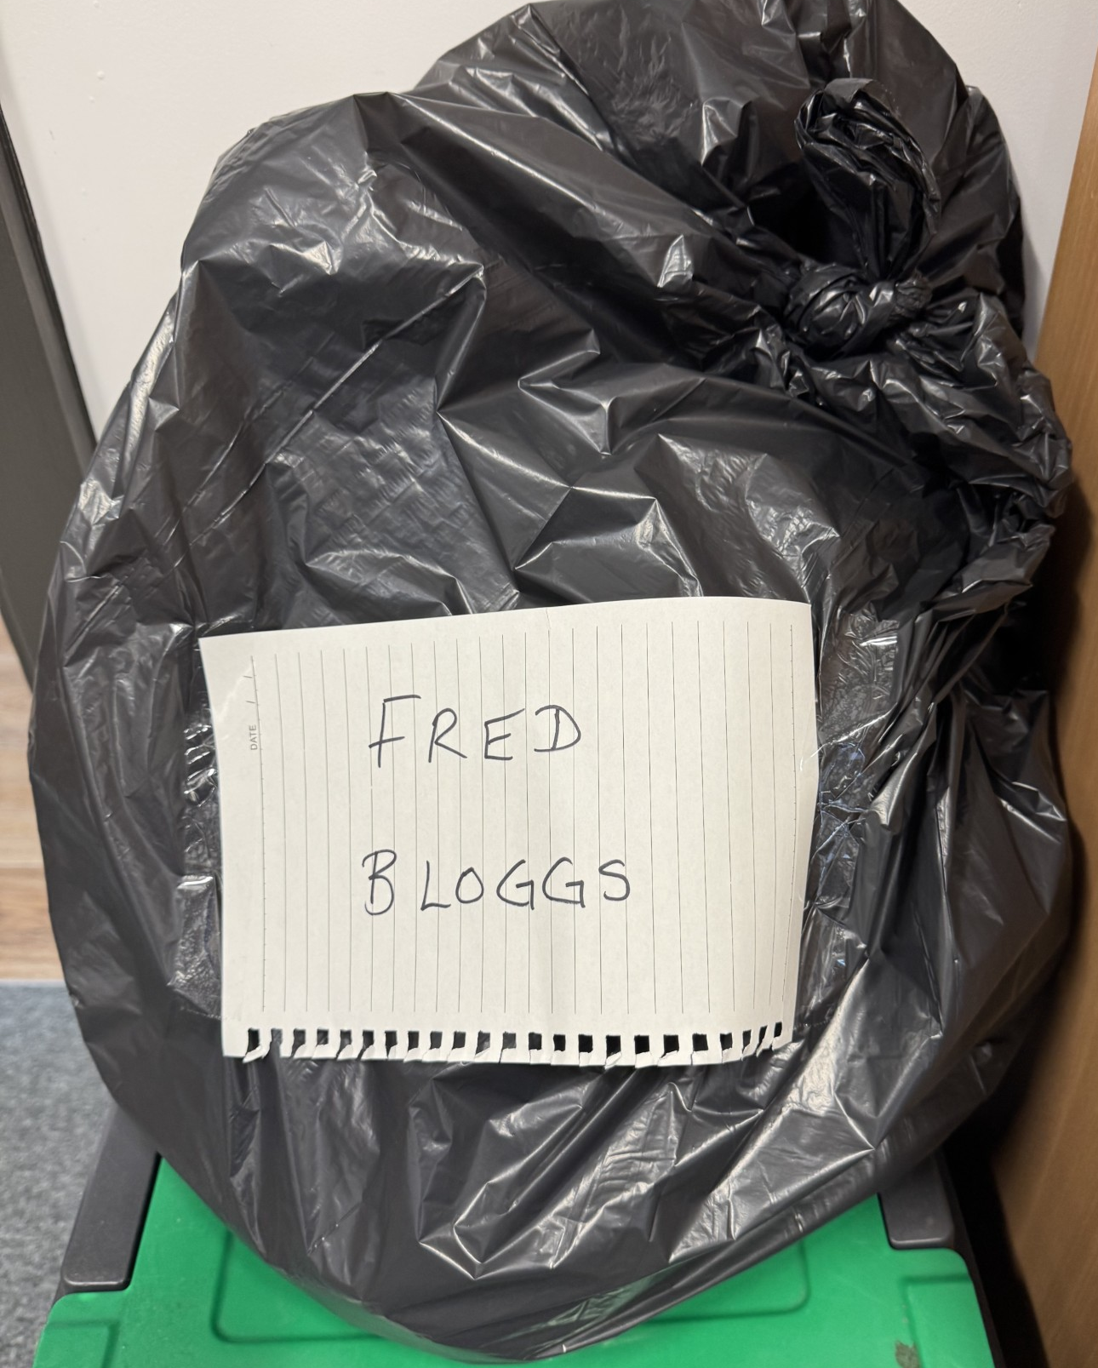
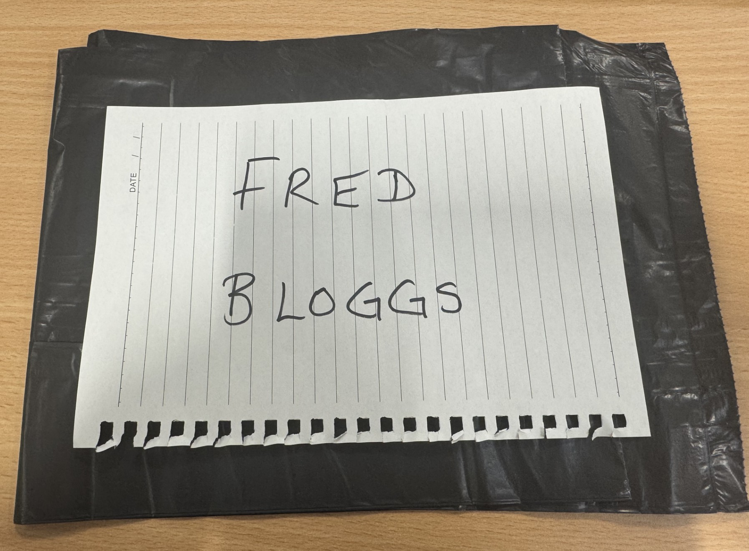
Sleep bag and pillow outward
Separate Bin bag labelled for return journey

Slide 6
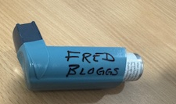
Morning of departure – 8am arrival
‘Check – in’ to The ALEXANDER HALL – entrance opposite Reception classes
Locate your child’s activity group and adult – lists will be displayed on the door as you come in
Hand any medication/travel sickness pills etc. to your allocated adult (labelled). EXCLUDING Asthma inhalers/pumps, children need to keep these on them at all times (2 x Asthma inhalers, one for child to keep on them one handed in to group leader)
Once your child has ‘checked-in’, please make your way outside to prepare for our departure
8.20 – FAREWELLS & BOARDING
8.30 – COACH DEPARTS

Slide 7

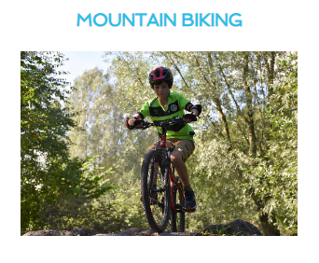

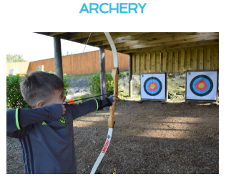
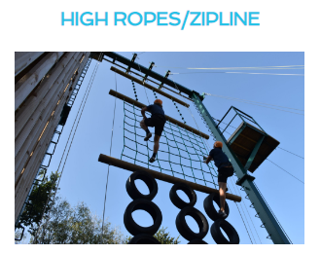
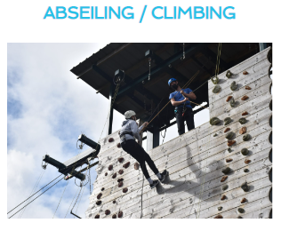
Programme of activities
A copy of our programme of activities will be available on the morning of departure – a copy will also be posted onto the school website

Slide 8

Snacks
Children are permitted to bring a small amount of snacks for the coach journey – NO FIZZY DRINKS
Please do not give your child a LOT of snacks – they will be very
well-fed throughout the day at Morfa Bay
We have a number of pupils with severe nut allergies, therefore we cannot have any nuts or products that contain nuts at Morfa Bay
This includes peanut butter and chocolate spread.

Slide 9
Food … glorious food!
Children have already pre-ordered all of their meals
If there are foods that your child can not/ will not eat – there will be alternatives available, the staff are extremely experienced in dealing with fussy eaters!
Lots of children try new foods at Morfa Bay and end up loving them!
School provide a packed lunch for the children on Monday (Tuna, cheese or ham) but please send them in with a drink……

Slide 10
Daily Updates
We will ‘try’ to post a daily update on Facebook – these posts will also be transferred on to our school website. But please be patient as it is reliant on staff availability and wifi. The signal at Morfa isn’t great!!!
Photo permission is required (a member of staff will be in contact if you have any restrictions currently)

Slide 11
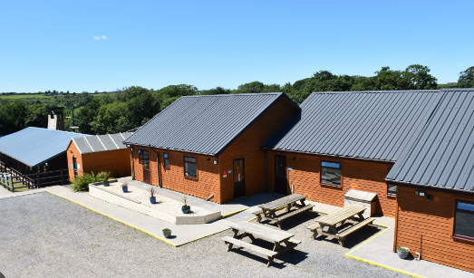
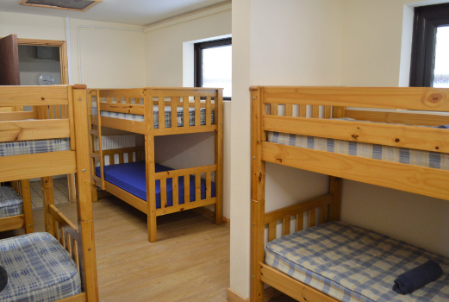
Accommodation
Children will find out their accommodation ‘Dorms’ on arrival at Morfa Bay

Slide 12
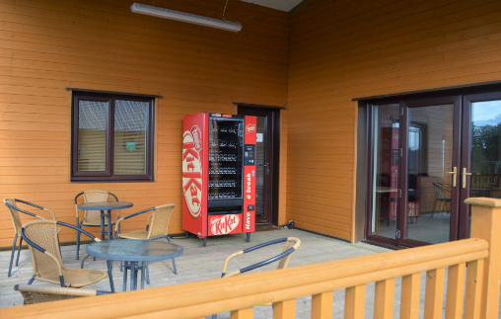
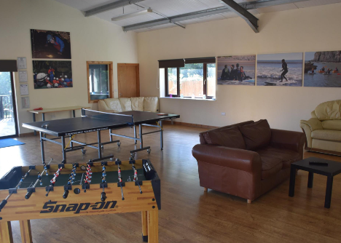
On-site at Morfa Bay – The Crow’s Nest

Slide 13


HOMESICKNESS …
Feeling a little bit homesick is REALLY NORMAL …
Everyone feels like this at some point
We all help each other
We develop resilience, confidence and self-esteem through overcoming our fears!

Slide 14
Sickness
If you child is taken ill and we and the on-site team feel that they need to be collected – you or a family member must be available to do so

Slide 15
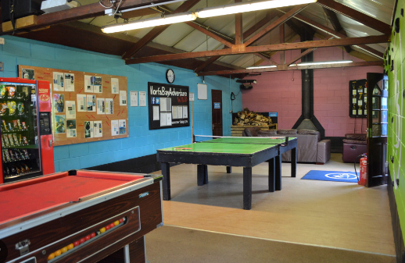
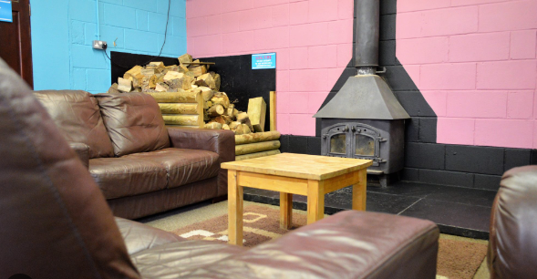
On-site at Morfa Bay – The Games Room

Slide 16
Pocket money
Children may bring a maximum of £10 (in pound coins)
This can be sent in to the office from today, in a named sealed envelope (not in purses/wallets)
Group leaders will look after this money
Children will be able to ‘withdraw’ coins from their ‘account’ at a time agreed with adults

Slide 17
Contact
We are aware that some staff attending are friends with some of our parents and families.
However, we have a strict policy of NO contact.
This is the same for staff members children who attend

Slide 18

No technology allowed …
No devices are allowed at Morfa bay
No cameras or watches with the ability to message
Children may bring card games, colouring pads, books etc …
Group leaders will ‘check-in’ with pupils AND parents on the morning of departure – please help us by ensuring your child doesn’t try to ‘sneak’ anything in…..
If any devices are found they will be confiscated until our return

Slide 19
MEDICATION
Medical forms have all been received – THANK YOU!
Please contact a member of the team if anything needs updating
Please be honest! If your child wets the bed, sleep walks or has night terrors etc. we need to know……….
Any pull-ups MUST be brought into school the week before the trip in a sealed named carrier bag for the attention of Mrs Driscoll

Slide 20
Another school joining us
This year, we will be sharing the site with another school
All accommodation is kept separate
Meal times are shared…..
This won’t impact on our experience……

Slide 21

If you think of anything after the meeting, or were unable to attend, please email office@ashcombeprimary.co.uk where a member of the team will be able to help

